Slide 1
MT104 – LINEAR ALGEBRA
Course Instructor:
Osama Bin Ajaz
Lecturer at FAST – NUCES,
Main Campus, Karachi.

Slide 2
Elementary Matrices and a Method for Finding A⁻¹

Slide 3
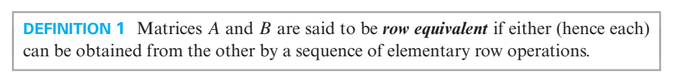
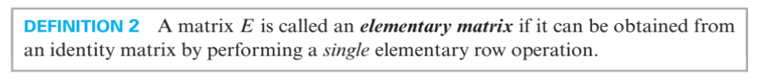
Elementary Matrix

Slide 4
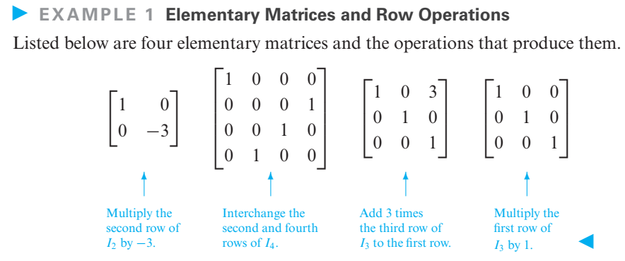

Slide 5
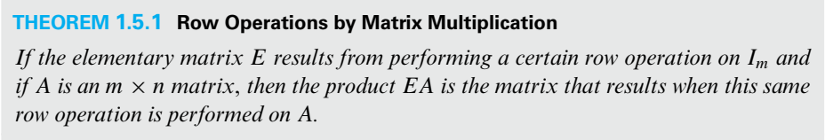

Slide 6
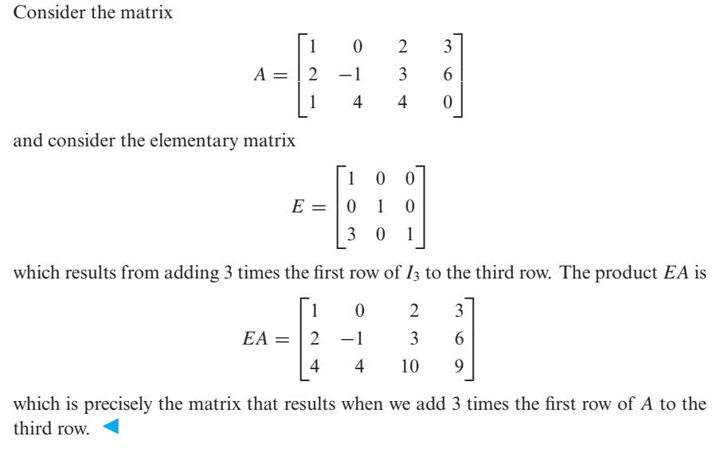
Example: Using Elementary Matrix

Slide 7
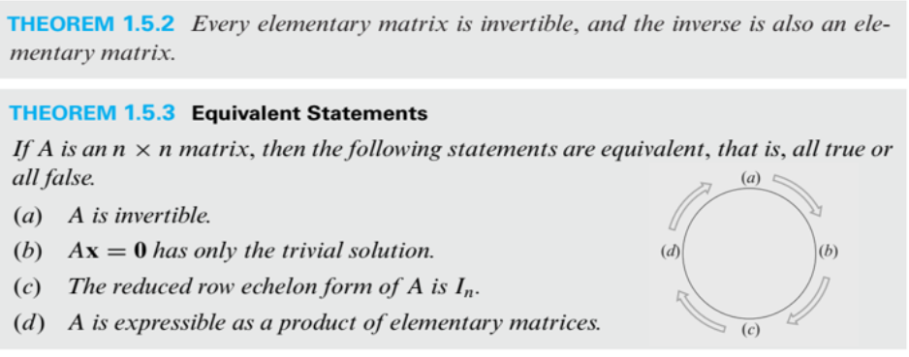

Slide 8
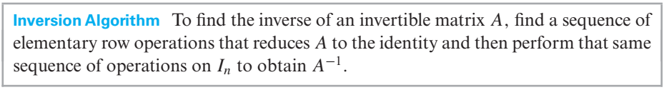
Algorithm for inverting Matrices

Slide 9
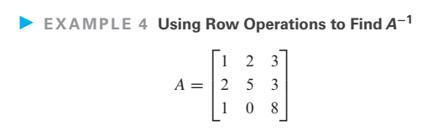


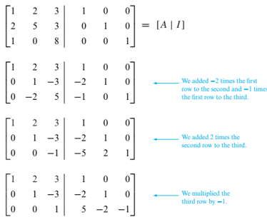
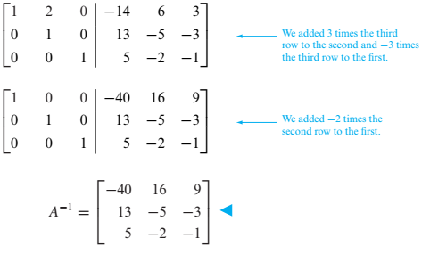
The computations are as follows:
Thus,
Notes:
The system is invertible and therefore the it has trivial solution.

Slide 10
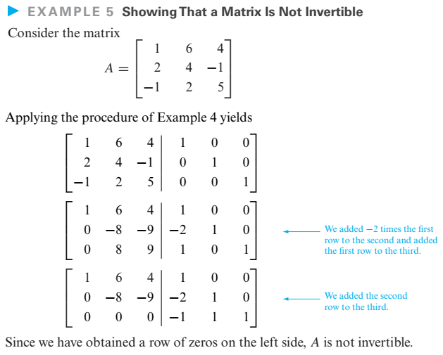
Notes:
The system is not invertible therefore, the system has nontrivial solution.

Slide 11
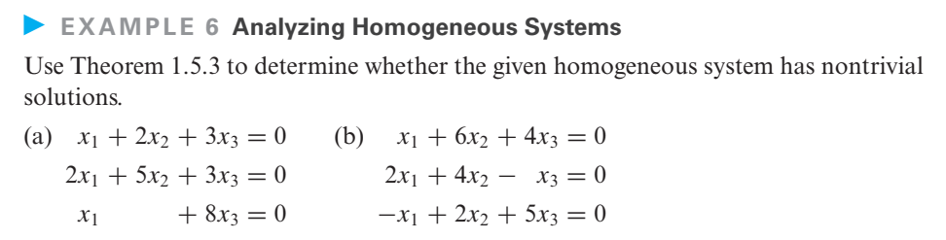
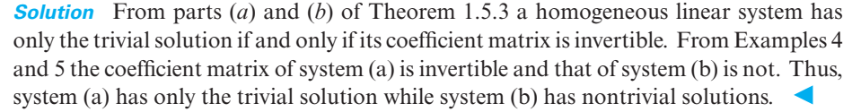

Slide 12
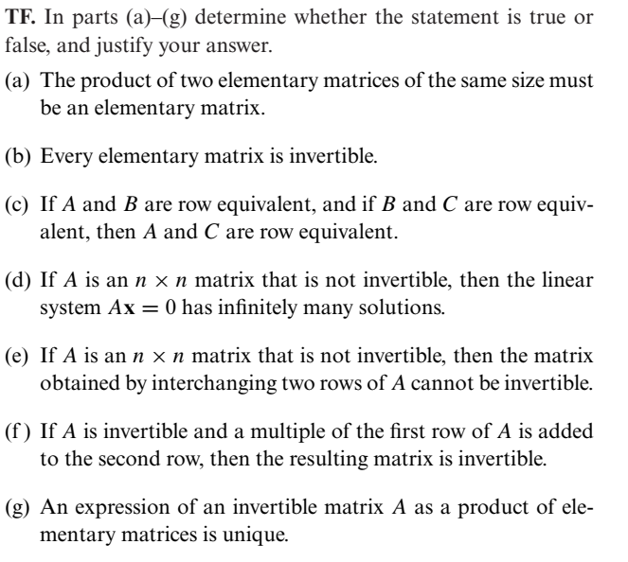
TRUE – FALSE EXERCISES
FALSE
TRUE
TRUE
TRUE
TRUE
TRUE
FALSE

Slide 13
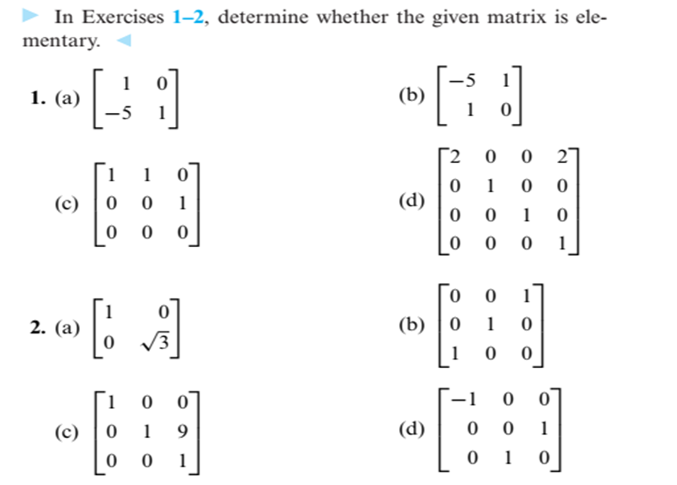
ELEMENTARY
Not an Elementary Matrix
Not an Elementary Matrix
Not an Elementary Matrix
ELEMENTARY
ELEMENTARY
ELEMENTARY
Not an Elementary Matrix

Slide 14
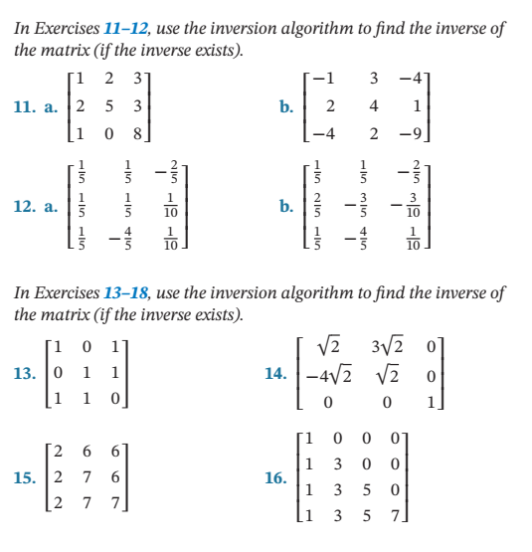
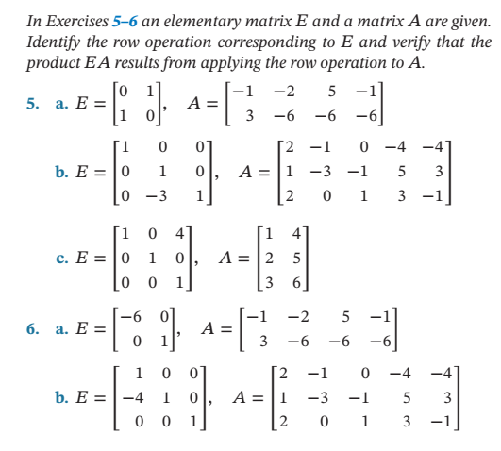

Slide 15
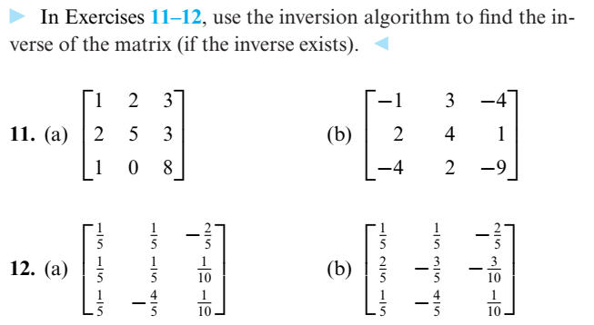
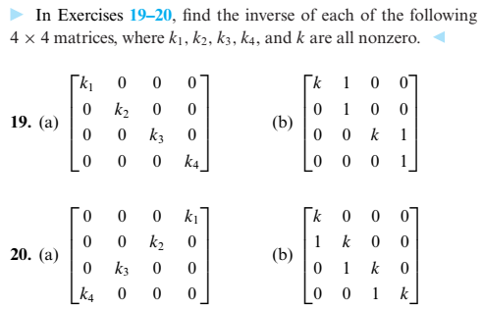

Slide 17

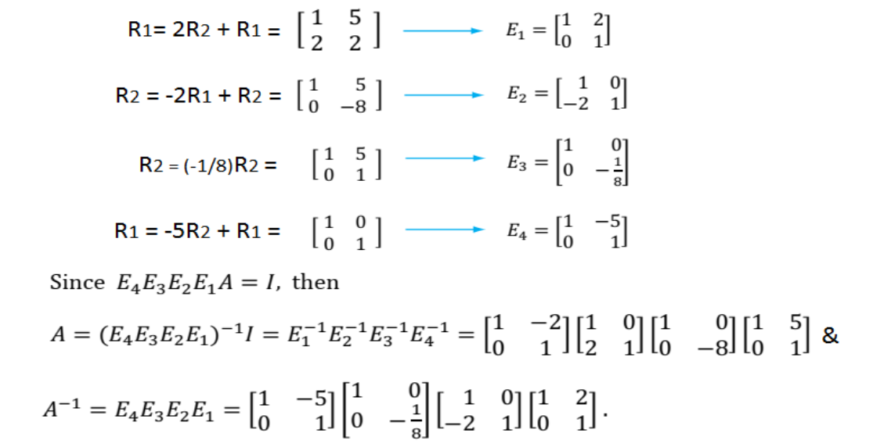
Matrix & its inverse as a product of Elementary Matrices
Notes:
Exercise 23

Slide 18

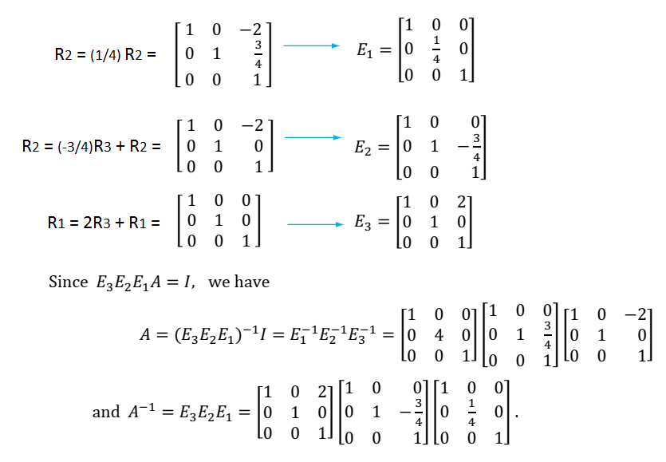
Express the following matrix & its inverse as a product of elementary matrices

Slide 19
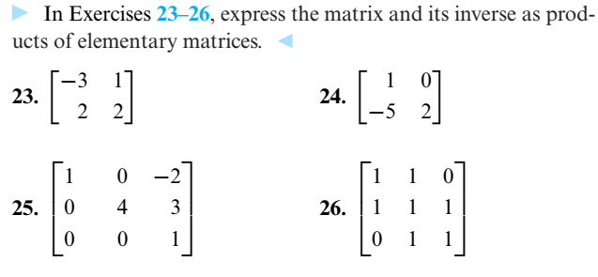

Slide 20
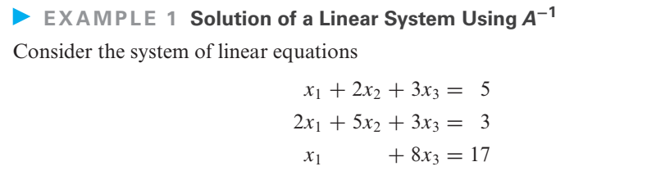
Solving Linear Systems by Matrix Inversion

Slide 21
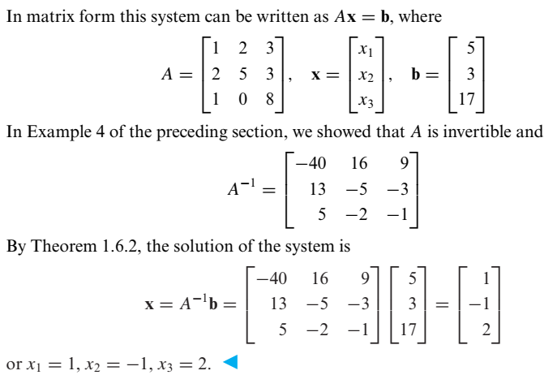

Slide 22
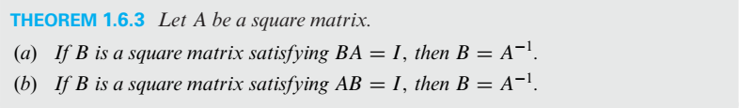
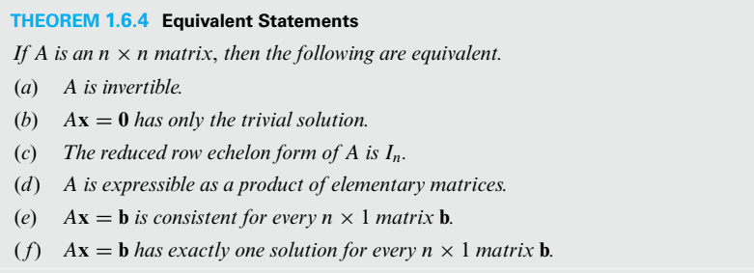
Properties of Invertible Matrices

Slide 23
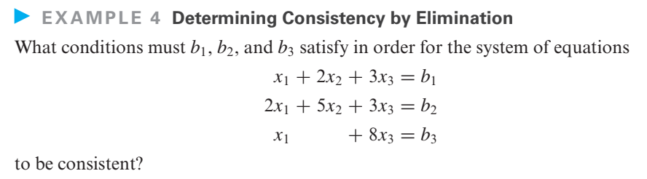
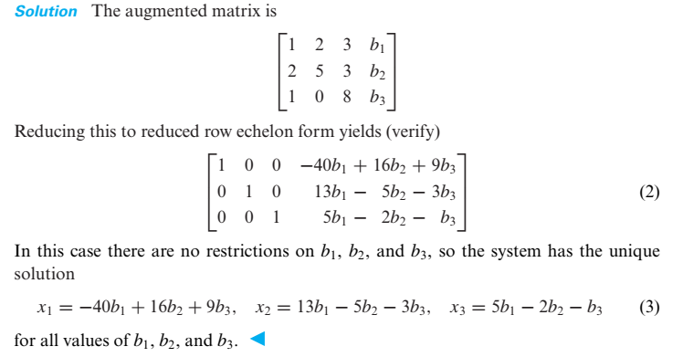

Slide 24
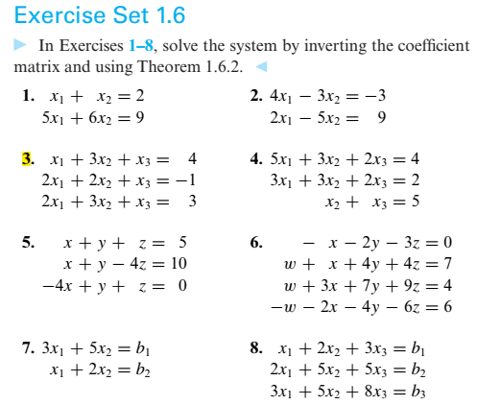

Slide 25
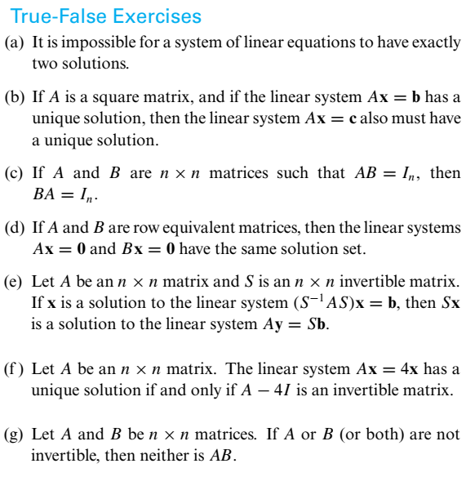
TRUE
TRUE
TRUE
TRUE
TRUE
TRUE
TRUE
Notes:
For (c), see theorem 1.6.3, page # 63

Slide 26
DETERMINANTS (Cofactor Expansion, Row Reduction, Cramer’s Rule)

Slide 27
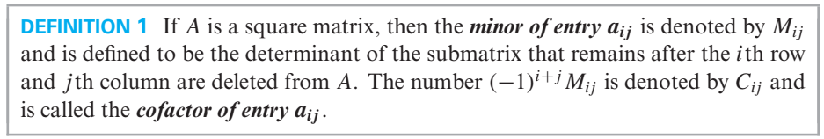
Determinants by Cofactor Expansion

Slide 28
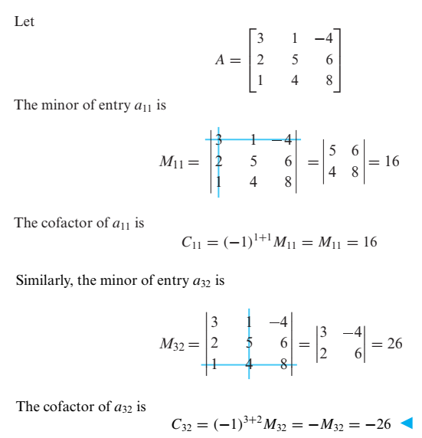
Example # 01 (Finding Minors & Cofactors)

Slide 29
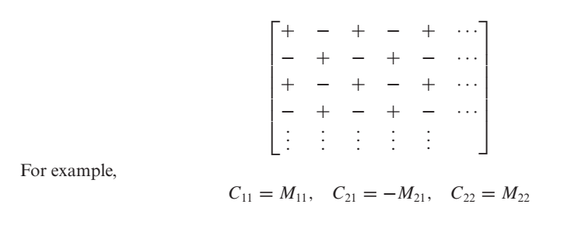
Checkerboard Array

Slide 30
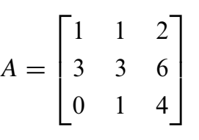
Example: Find all minors and cofactors:
Notes:
Det(A) = 0

Slide 31
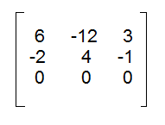

Slide 32
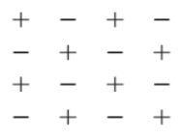
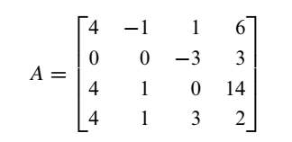
Example: Find all cofactors
Notes:
Det = -216

Slide 33
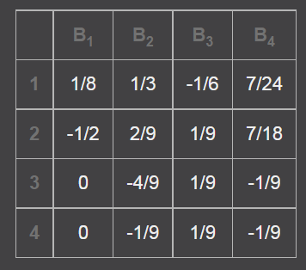

Slide 34
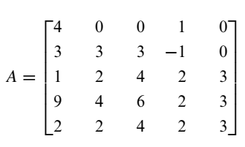
Example: evaluate det(A) by a cofactor expansion
along a row or column of your choice

Slide 35


Slide 36
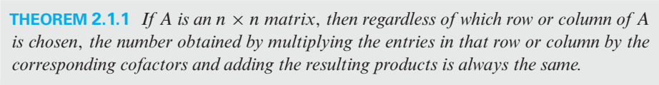
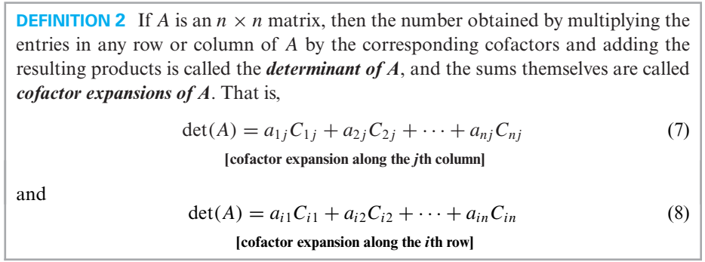

Slide 37
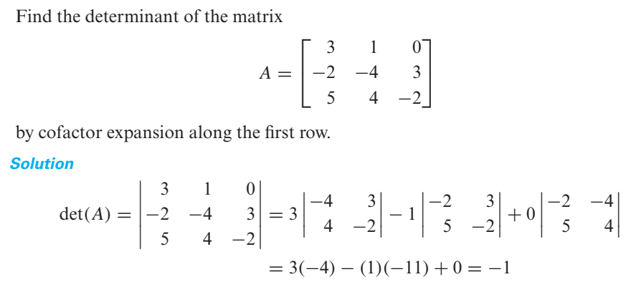
Example # 02 (Cofactor expansion along the first row)

Slide 38
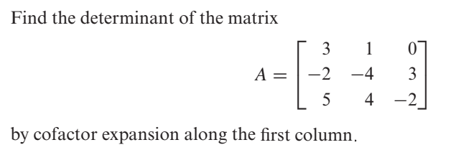
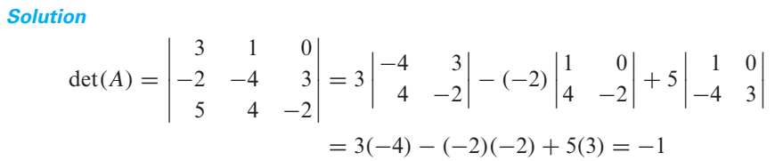
Example # 03 (Cofactor expansion along the first column)
Now see previous slide.

Slide 39
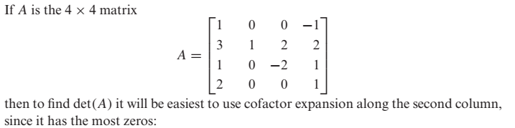
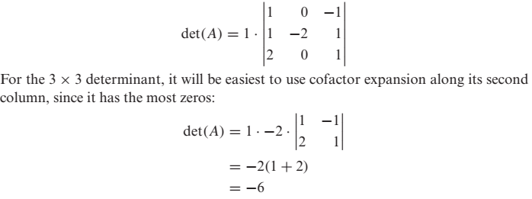
Example # 4 (Smart Choice of Row or Column)

Slide 40
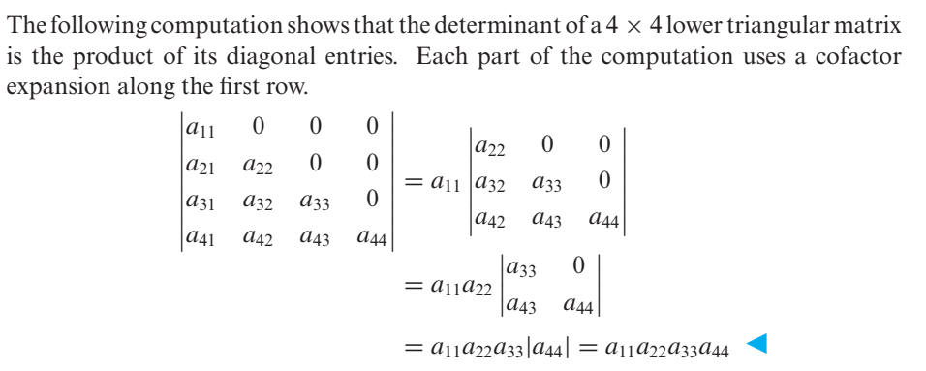
Example # 05 (Determinant of a lower triangular matrix)

Slide 41
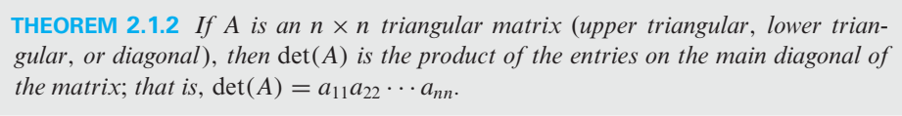

Slide 42
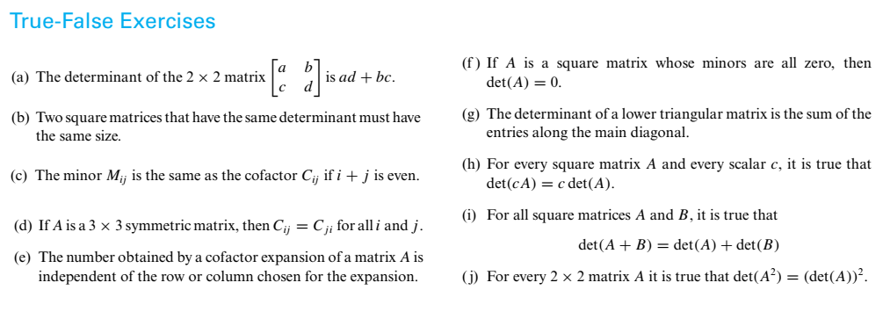
True-False Exercises
TRUE
FALSE
FALSE
FALSE
TRUE
FALSE
FALSE
TRUE
TRUE
TRUE

Slide 43
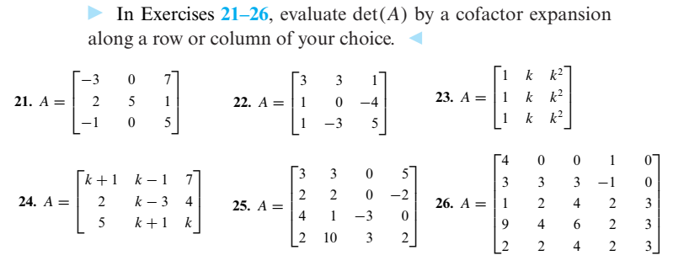
Exercise Set 2.1:

Slide 44

Exercise Set 2.1 (contd.)

Slide 45

Evaluating Determinants by Row Reduction

Slide 46

Determinants of Elementary matrices

Slide 47

Matrices with proportional rows or proportional columns

Slide 48


Slide 49


Slide 50

TRUE
TRUE
FALSE
FALSE
TRUE
TRUE

Slide 51

Exercises Set 2.2:

Slide 52

Exercise 2.2 (Contd.)

Slide 53
PROPERTIES OF DETERMINNATS

Slide 54

PROPERTIES OF DETERMINNATS

Slide 55


Slide 56

Determinant of a Matrix Product

Slide 57



Adjoint of a Matrix

Slide 58


Inverse of a Matrix Using its Adjoint

Slide 59

CRAMER’S RULE

Slide 60


Slide 61


Slide 62

TRUE-FALSE

